Slide 1



DRE - Demonstrativo de Resultado
View in Power BI
Last data refresh:
11/08/2025 20:16:01 UTC
Downloaded at:
11/08/2025 20:18:52 UTC

Slide 2
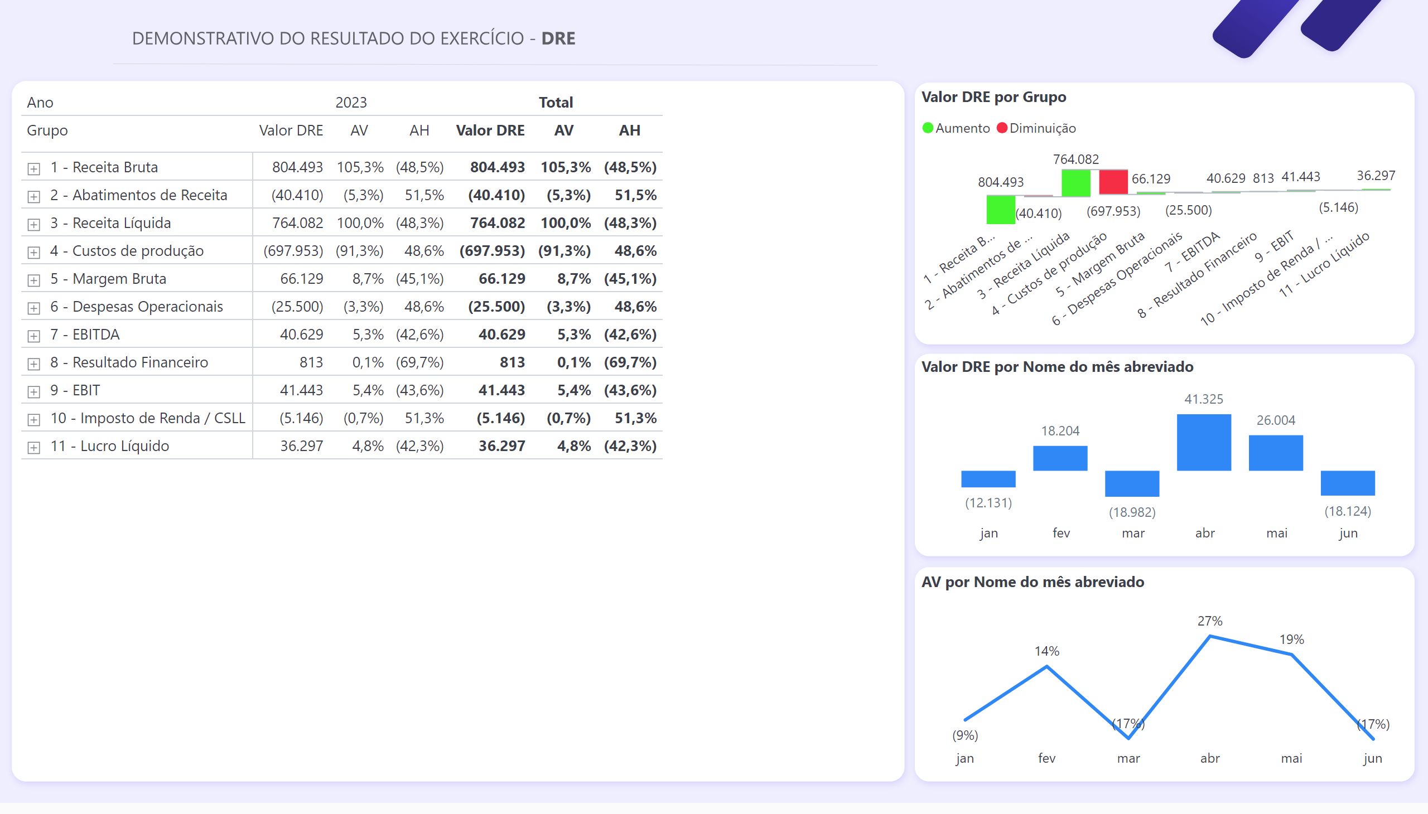
Resumo
Notes:
pivotTable
No alt text provided
waterfallChart
No alt text provided
clusteredColumnChart
No alt text provided
lineChart
No alt text provided

Slide 3
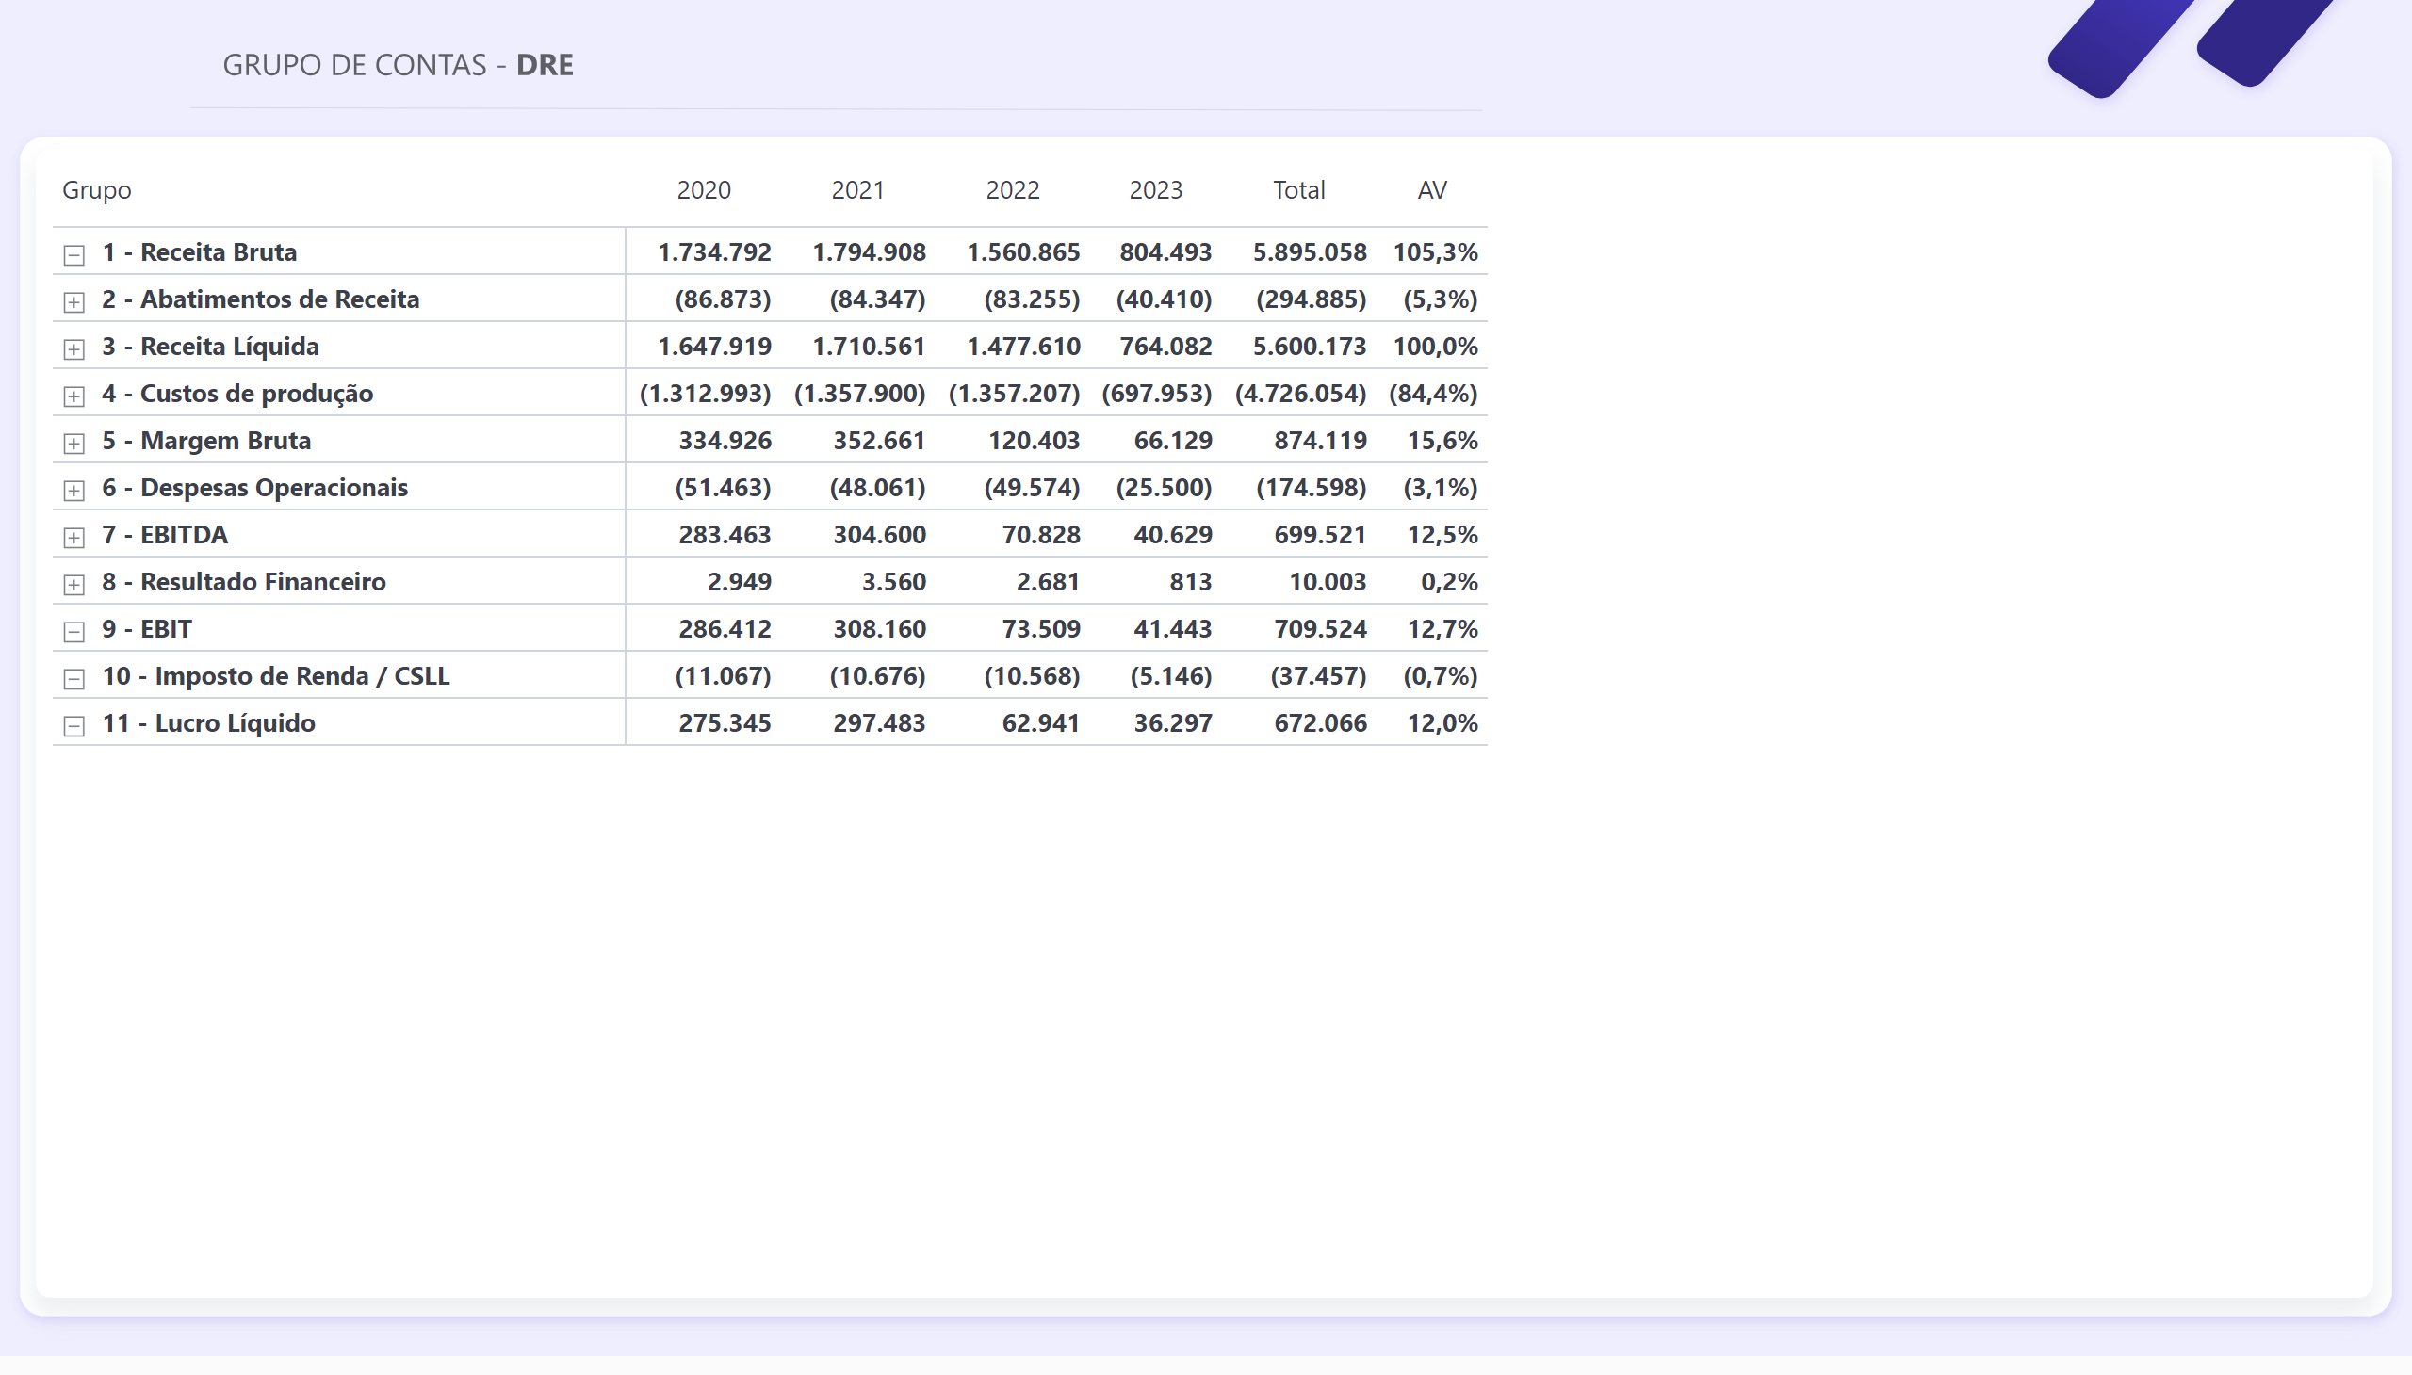
Grupo de Contas
Notes:
pivotTable
No alt text provided

